Slide 1
Animation 2024
Archie Thomas

Slide 2
Hayao Miyazaki
Creator of Studio Ghibli
Miyazaki's Princess Mononoke (1997) was the first animated film to win the Japan Academy Film Prize for Picture of the Year and briefly became the highest-grossing film in Japan.
Miyazaki
Source:
Hayao Miyazaki - Wikipedia

Slide 3
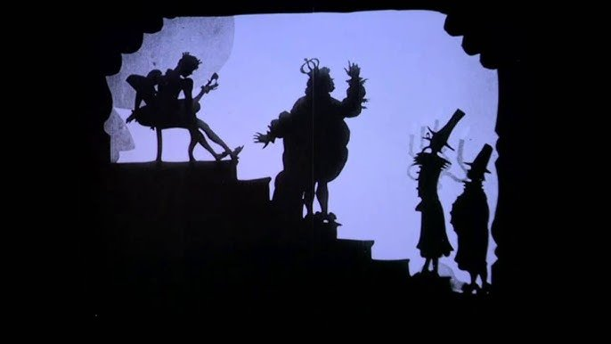
Fundamentals of animation (Slide 1)
Lotte Reiniger-
Lotte Reiniger was a German film maker who was the first in history to create a silhouette feature length animated film.

Slide 4
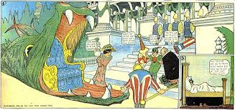
Fundamentals of animation (Slide 2)
Winsor Mccay-
McCay made four thousand drawings on rice paper for his first animated short, which starred his Little Nemo characters; Live-action sequences were added to the beginning and end of the film

Slide 5
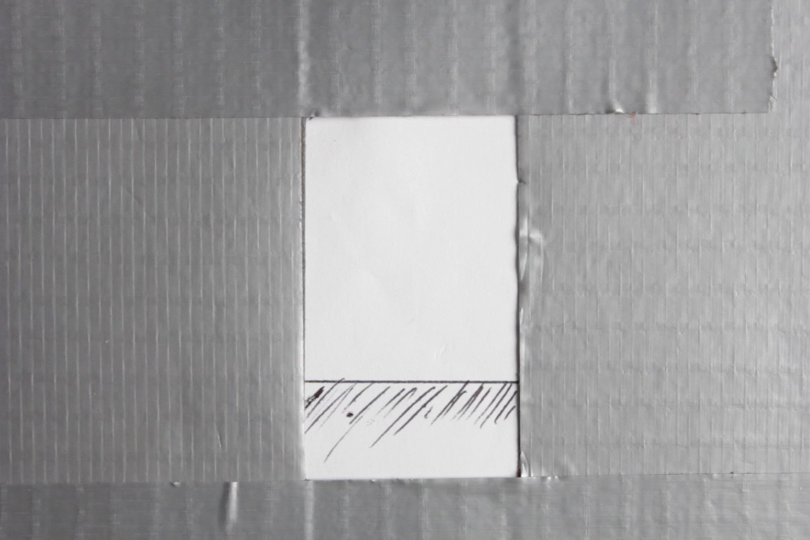
Comic Strip Animation (Zoetrope)
We recreated the Zoetrope created by a 'William Horner'
A Zoetrope is a row of images that create an animation when spun around and projected flashing light upon it.
Mine: 00:11 to 00:13

Slide 6
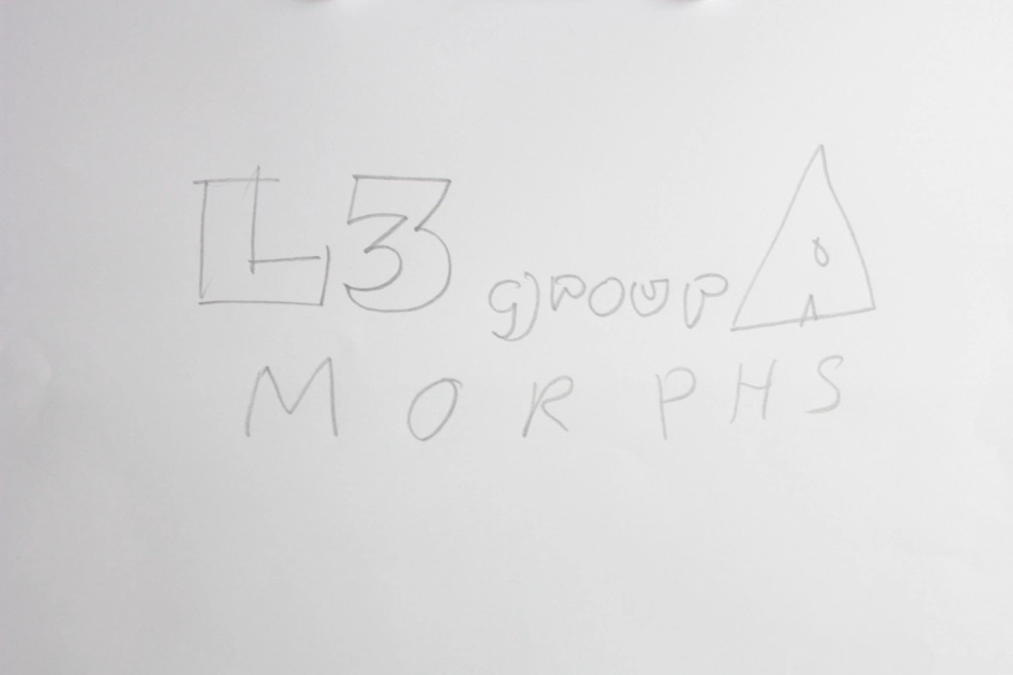
Animation Morphs
My morph is at, 00:12 to 00:14
We created our own version of an animation morph, first created by Joseph Plateau.
A Morph is a series of images that use key frames (Key frames a major moments in an animation) to change from one image to another e.g. A person into a banana.

